Slide 1

NEWS POPULARITY PREDICTION
Pooja Laxmi Sankarakameswaran

Slide 2
TABLE OF CONTENTS
PROBLEM SETTING
PROJECT DEFINITION
DATA SOURCE, DATA DESCRIPTION, DATA EXPLORATION
DATA MINING TASKS
DATA MINING MODELS
PERFORMANCE EVALUATION
PROJECT RESULTS, INSIGHTS FOR DECISION MAKING
PROJECT OUTCOMES

Slide 3
PROBLEM SETTING
- Virality is vital in the digital era, shaping public discourse through engagement and sharing.
- Predicting news popularity helps Mashable optimize content and engage users effectively.
- Without prediction, Mashable risks competitiveness, suboptimal engagement, and inefficient resource allocation.
- Predictive capability is a strategic asset for proactive content optimization and user interaction.
- Absence of prediction hinders Mashable's adaptation to trends and effectiveness in the digital media landscape.

Slide 4
PROJECT DEFINITION
- Project goal: Predict popularity of Mashable articles over two years using diverse features.
- Dataset: Includes article statistics; aims to build a predictive model for social shares.
- Objective: Understand factors affecting article popularity for content optimization.
- Importance: Provides insights for content creators and publishers to enhance social media engagement.
- Strategic value: Optimizes strategies based on predictive analysis of article popularity.

Slide 5
DATA DESCRIPTION & DATA SOURCE
- Dataset overview: 39797 instances with 61 variables.
- Variable types: 58 predictive, 2 non-predictive, 1 target/response variable.
- Target variable: "shares" - numerical, indicating article shares.
- Abridged description: Detailed breakdown of variables provided below.
- Focus on target: Understanding and predicting article sharing behavior.
- Data Source: Online News Popularity Dataset available on the UCI Machine Learning Repository.
Groups of Variables:
● Non predictive variables
● Number of words in categories
● Number of aachents
● Average article length
● Data Channel
● Keyword statistics
● Self Reference statistics
● Day of Publication
● LDA Details
● Global Effect Rates
● Polarity statistics
● Title and Absolute Title polarity

Slide 6
DATA EXPLORATION
- Exploratory data analysis (EDA): Differentiation between numeric and categorical variables yielded insights into content characteristics.
- Title length: Typically around 7 tokens, with a consistent interquartile range despite outliers indicating longer titles.
- Content length: Median token count is modest, yet high variability observed, with a significantly elevated upper quartile and numerous outliers indicating notably longer content.
- Observations: Most entries have moderate content length, but a considerable amount exhibit longer content.
- EDA significance: Provides nuanced understanding of content characteristics and variability within the dataset.

Slide 7
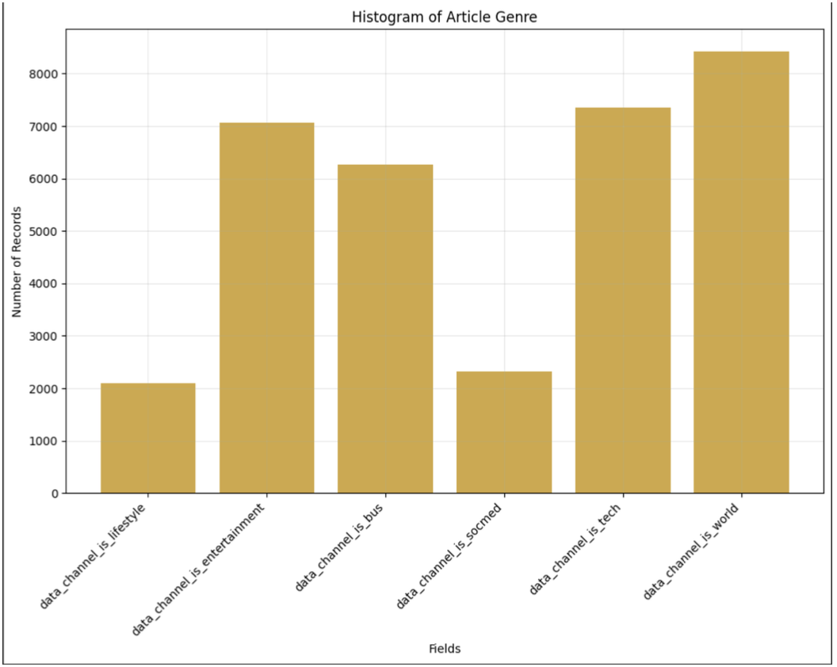
EXPLORATORY DATA ANALYSIS

Slide 8
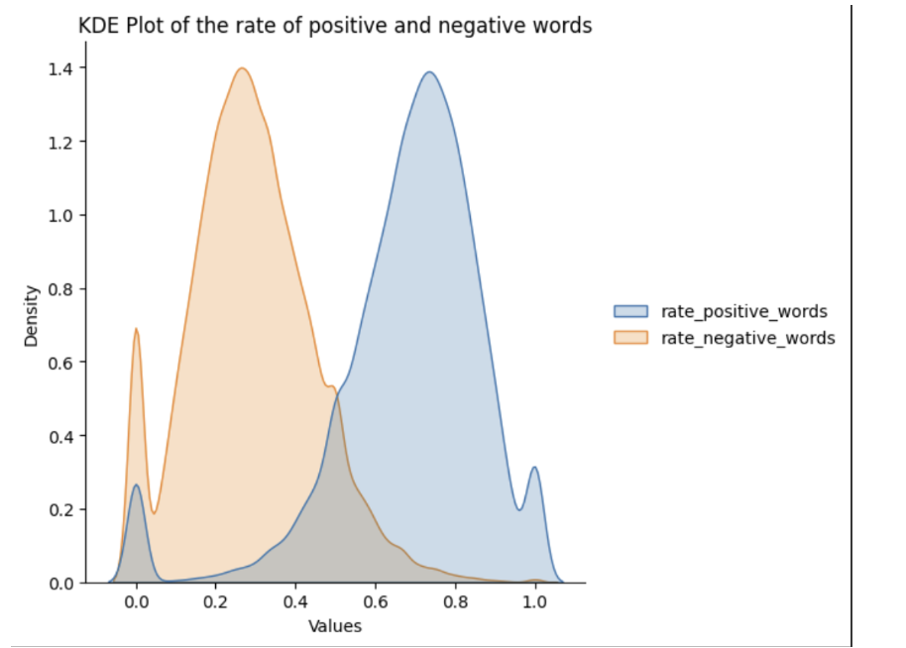
EXPLORATORY DATA ANALYSIS

Slide 9
DATA MINING TASKS FEATURE SELECTION
- Feature selection method: Utilized Recursive Feature Elimination (RFE) technique.
- RFE process: Implemented Grid Search with diverse Wrapper models to identify best-performing features.
- Wrapper models: Included Random Forest Classifier and Logistic Regression.
- Wrapper model selection: Logistic Regression exhibited comparable performance to Random Forest Classifier but with faster speed, hence chosen as the Wrapper Model.
- Outcome: RFE technique identified 27 key features from the initial pool of 58 features.

Slide 10
FINAL FEATURE LIST
'n_tokens_content', 'num_hrefs', 'num_self_hrefs', 'num_imgs', 'num_videos', 'num_keywords',
'data_channel_is_entertainment', 'data_channel_is_tech', 'data_channel_is_world', 'kw_min_min',
'kw_max_max', 'kw_avg_max', 'kw_min_avg', 'kw_max_avg', 'kw_avg_avg',
'self_reference_min_shares', 'weekday_is_tuesday', 'weekday_is_wednesday',
'weekday_is_thursday', 'weekday_is_friday', 'weekday_is_saturday', 'LDA_02', 'LDA_03',
'global_subjectivity', 'global_sentiment_polarity', 'min_positive_polarity', 'min_negative_polarity'

Slide 11
DATA MINING MODELS
KNN Classifier
Logistic Regression
Random Forest Classifier
Decision Trees

Slide 12
PERFORMANCE EVALUATION

Slide 13
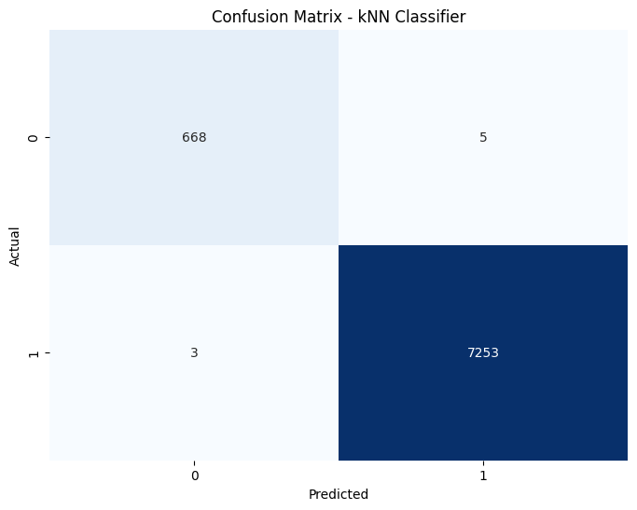
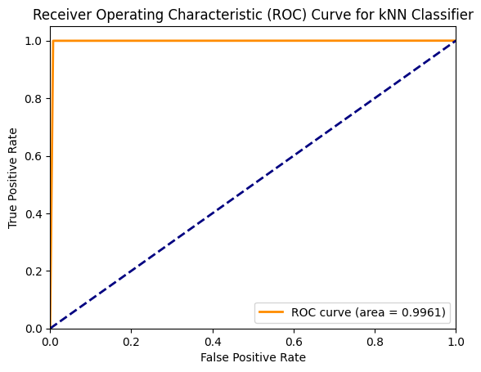
kNN CLASSIFIER
The kNN Classifier demonstrated an accuracy of 99.90%, precision of 99.93%, recall of 99.96%, F1 score of 99.94%, RMSE of 0.0318, R2 score value of 0.9870, AUC of 0.9961, and mean CV score of 0.9706.

Slide 14

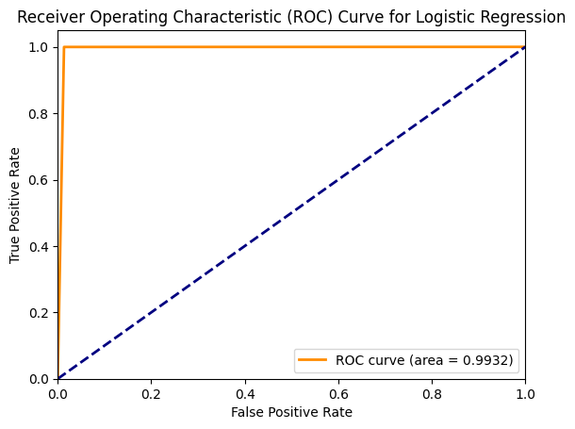
LOGISTIC REGRESSION
Logistic Regression exhibited strong performance with an accuracy of 99.86%, precision of 99.88%, recall of 99.97%, F1 score of 99.92%, RMSE of 0.0372, R2 score value of 0.9821, AUC of 0.9932, and mean CV score of 0.9916.

Slide 15
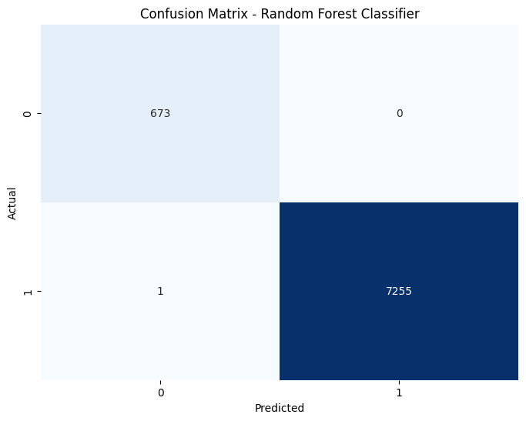
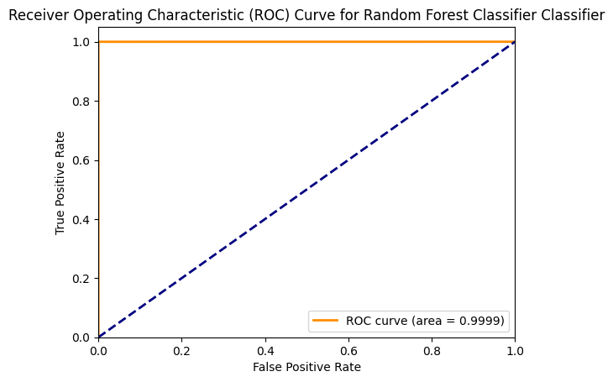
RANDOM FOREST CLASSIFIER
The Random Forest Classifier demonstrated excellent performance, achieving an accuracy of 99.99%, precision of 100%, recall of 99.99%, F1 score of 99.99%, RMSE of 0.0112, R2 score value of 0.9984, AUC of 0.9999, and mean CV score of 0.9979.

Slide 16

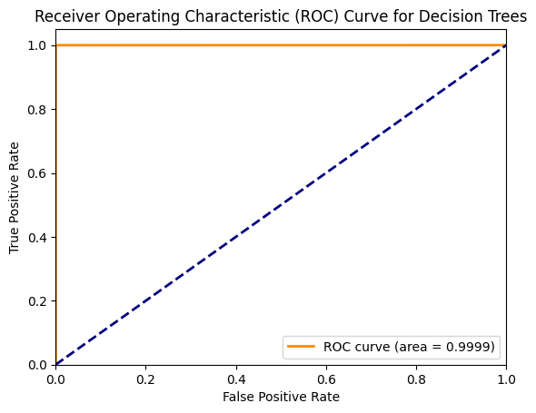
DECISION TREES
The Decision Trees model delivered outstanding performance, with an accuracy of 99.99%, precision of 100%, recall of 99.99%, F1 score of 99.99%, RMSE of 0.0112, R2 score value of 0.9984, AUC of 0.9999, and mean CV score of 0.9997.

Slide 17
PROJECT RESULTS
Based on the model performance summary, the Random Forest Classifier emerges as the top-performing model, showcasing exceptional accuracy, precision, recall, and F1 score, along with superior RMSE, R2 score value, AUC, and mean CV score.
Model Name | Accuracy | Precision | Recall | F1 Score | RMSE | R2 Score Value | AUC | Mean CV Score
kNN Classifier | 0.998991 | 0.999311 | 0.999587 | 0.999449 | 0.031764 | 0.98701 | 0.996079 | 0.970639
Random Forest Classifier | 0.999874 | 1 | 0.999862 | 0.999931 | 0.01123 | 0.998376 | 0.999931 | 0.997906
Logistic Regression | 0.998613 | 0.998761 | 0.999724 | 0.999242 | 0.037247 | 0.982139 | 0.993176 | 0.99155
Decision Trees | 0.999874 | 1 | 0.999862 | 0.999931 | 0.01123 | 0.998376 | 0.999931 | 0.999697

Slide 18
INSIGHTS FOR DECISION MAKING
1. Optimize article length and multimedia content (images, videos) to maintain reader engagement.
2. Use relevant keywords and trending topics for better discoverability and relevance.
3. Tailor content to specific channels based on reader preferences and interests.
4. Publish articles on days with higher sharing trends to maximize exposure.
5. Ensure articles evoke strong emotions, maintain balanced sentiment, and reference successful previous content for increased engagement and virality.

Slide 19
PROJECT OUTCOMES
- Successfully employed machine learning techniques to predict article popularity based on various features.
- Identified key factors influencing article virality, including content length, multimedia usage, keyword optimization, and publishing timing.
- Leveraged advanced algorithms such as Random Forest Classifier for accurate predictions.
- Provided actionable insights for content creators to optimize articles for increased social media engagement.
- Demonstrated the importance of tailoring content to specific audience preferences and interests.
- Facilitated informed decision-making processes within the company to enhance content strategy and maximize audience reach.

